Slide 1
Understanding the S&P MidCap 400
F427: ML & AI in Investing

Slide 2



What is this class about?
2
Machine Learning
Computer algorithms that can improve automatically through experience and the use of data
Artificial Intelligence
Having computer systems perform tasks that normally require human intelligence
Investing
Expending money with the expectation of earning a profit or material result

Slide 3

Supervised Machine Learning
Supervised Learning: use labeled datasets to make predictions about similar labeled datasets
Labeled data: data where the structure and variables are known
Regression analysis: predicting default
Classification: separating spam from useful email

Slide 4
Unsupervised Machine Learning
Generate predictions for unlabeled datasets
Unlabeled data: Data where structure and variables are unknown
Clustering: breaking data into smaller groups of similar objects – image compression
Association: “customers who bought this item also bought …”
Dimensionality reduction

Slide 5
Which type of learning in investing?
In active investing, our goal is to predict which stocks will perform better than others
Supervised learning: associate known data with known outcomes in order to make future predictions
Goal: predict robust outcomes
Unsupervised learning: create associations among groups of unknown data without outcome variables
Goal: understand data structure

Slide 6
Our task
Our objective is to use machine learning to identify factors that appear to explain returns on stocks in the S&P MidCap 400 index, and use this analysis to make recommendations on stocks to construct a hypothetical investment fund.
For example, we know that small market capitalization stocks and stocks with a high book value of equity compared to market value (sometimes referred to as "value stocks") have historically earned higher returns than large market capitalization stocks and stocks with a low book value of equity compared to market value (sometimes referred to as "growth stocks"). So one example would be to use machine learning techniques to test the relationship between a company's market capitalization, its book-to-market ratio, and past returns, and make a recommendation on whether we should put a stock in the portfolio on the basis of its value versus growth characteristics.
That is just one example. Over the course we will investigate other factors that rely upon analyst earnings forecasts, industry classification, companies' past investments, and companies' historical profitability. Students will work in groups to perform analysis and ultimately make portfolio recommendatio
6

Slide 7
The road ahead
Topic | Quantitative technique
Understanding the S&P MidCap 400 | Compilation of cumulative returns
Defining our performance objective: Alpha versus a passive investment in the benchmark | Ordinary Least Squares (OLS) regression
Stock characteristics that are plausibly indicators of alpha (signals): value, quality, smart money, momentum
Overfitting and testing results out of sample
Introduction to machine learning
Overfitting and penalized regression | Least absolute shrinkage & selection operator (LASSO) regression
Non-linearity in the relationship between signals and returns | Decision trees: Basic
Non-linearity in the relationship between signals and returns, combined with over-fitting | Decision trees: Random forests
Non-linearity in the relationship between signals and returns, combined with over-fitting | Decision trees: Gradient boosting
Sophisticated identification of relationships between signals and returns | Neural networks
Comparison of machine learning techniques

Slide 8
Indices vs exchange-traded funds (ETFS)
An index is a fictional portfolio
Standard and Poor’s decides which securities are in the S&P MidCap 400 index.
PDF: S&P MidCap 400 Fact Sheet
https://www.spglobal.com/spdji/en/indices/equity/sp-400/#overview
Excel: S&P 400 Descriptive
FactSet list
FactSet formulas and hard-coded inputs
In a market capitalization-weighted index, each security is held based on its proportion of total market capitalization. Not all indices are market capitalization-weighted.
The market value of all 401 securities in the index is $2,276 billion (at about December 14, 2022)
The largest security is Steel Dynamics Inc (STLD) worth $19 billion, or 0.84% of the index. The company is in FactSet Economic Sector Non-Energy Minerals and FactSet Industry Sector Steel.
The smallest security is Greif Inc Class A (GEF) worth $2 billion or 0.08% of the index. The company is in FactSet Economic Sector Process Industries, and FactSet Industry Sector Containers/Packaging.

Slide 9
Reproducing an index
In order to exactly reproduce the index, we would need $2.3 trillion dollars
Suppose we have $10,000 to invest
0.84% of $10,000 is $84
Not enough to buy one share of STLD at $108.66
ETFs are investment funds traded on an exchange
ETFs often mimic indices
However, there are active ETFs that attempt to earn higher returns than a benchmark
ETFs offer low cost diversification and exposure to assets that meet a specified criteria
An investor can easily allocate holdings across stocks in different countries, size (e.g. S&P 500 vs S&P MidCap 400 vs S&P SmallCap 600), style (e.g. value versus growth), and industry
A passive investor can diversify at low cost
An active investor can get bet on a theme, while mitigating company-specific risk

Slide 10
ETFs that track the S&P MidCap 400
Name | SPDR S&P MIDCAP 400 ETF Trust | iShares Core S&P Mid-Cap ETF
Ticker | MDY | IJH
ISIN | US78467Y1073 | US4642875078
Website | https://www.ssga.com/us/en/intermediary/etfs/funds/spdr-sp-midcap-400-etf-trust-mdy | https://www.ishares.com/us/products/239763/ishares-core-sp-midcap-etf
Assets | $18 billion | $64 billion
Gross exp ratio | 0.22% | 0.05%
Inception | May 4, 1995 | May 22, 2000
Shares | 41.47 million | 262.15
Net asset value | $443.55 | $242.26
Return: Incep | 11.21% v 11.59% S&P 400 | 9.34% v 9.46% S&P 400
Return: 10 yrs | 11.34% v 11.65% S&P 400 | 11.58% v 11.65% S&P 400

Slide 11
Index return example (1)
For illustrative purposes, assume there are 3 stocks in the index
ISIN | Name | Symbol | Sector | Industry
US8581191009 | Steel Dynamics | STLD | Non-Energy Minerals | Steel
US3032501047 | Fair Isaac Corp | FICO | Technology Services | Packaged Software
US3364331070 | First Solar, | FSLR | Electronic Technology | Semiconductors
The Excel file contains the following information on a monthly basis for 12 months ending November 2022:
Returns indices which include the reinvestment of dividends on the ex-dividend date
Number of shares
Price
Each month, compute market cap as number of shares × price.
Compute relative weights in the portfolio
Index return is a weighted average of returns on each stock

Slide 12
Index return example (2): Performance
This example index contains the 3 largest stocks in the S&P MidCap 400. The example index has a 12 month return of 75%.
The S&P MidCp 400 earned -3% in the year.
What led to this anomaly?
Survivorship bias.

Slide 13
Index return example (3)
Suppose we pick replicate the example with the 3 smallest stocks at year end.
ISIN | Name | Symbol | Sector | Industry
US3976241071 | Greif Inc Class A | GEF | Process Industries | Containers/Packaging
US9258151029 | Vicor Corp | VICR | Electronic Technology | Electronic Components
US8168501018 | Semtech Corp | SMTC | Electronic Technology | Semiconductors
In this example, index returns are -52%.
Implication: In testing a stock selection strategy we cannot define our investment universe on the stocks in the benchmark today, because maybe the survivors did better than the non-survivors. We need to test on the stocks that were in the index during the test period.

Slide 14
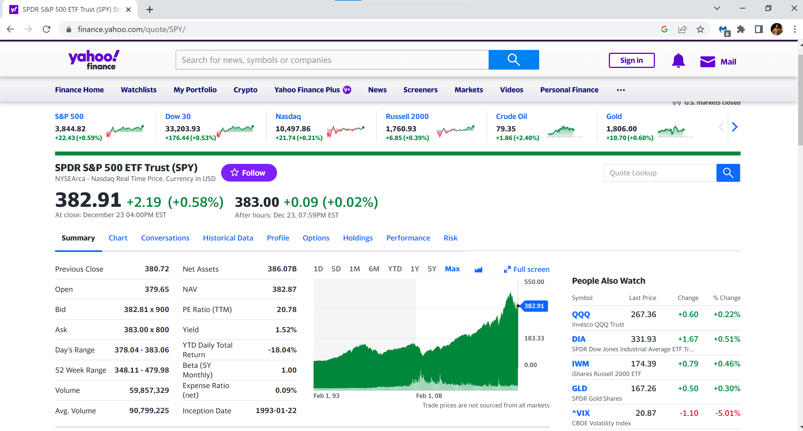
Import and view data (1): MDY v SPY
https://finance.yahoo.com/quote/SPY/

Slide 15
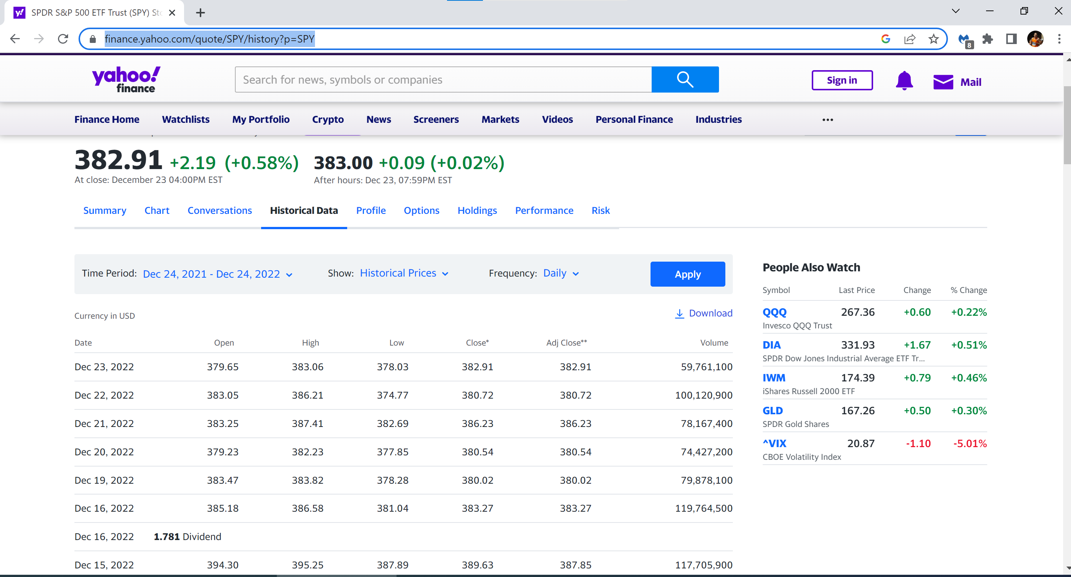
Import and view data (2)
https://finance.yahoo.com/quote/SPY/history?p=SPY

Slide 16
Import and view data (3)
# Import and view data import pandas as pd import numpy as np import matplotlib.pyplot as plt import yfinance as yf import datetime path = 'F:\\UM\Courses\\FIN427\\FIN427 Winter 2023\\' start = datetime.datetime(1995, 5, 4) end = datetime.datetime(2022, 12, 20) spy = yf.download('SPY', start=start, end=end) mdy = yf.download('MDY', start=start, end=end) print(mdy.columns) print(mdy.head()) print(mdy['Adj Close']) mdy['cumret']=mdy['Adj Close']/mdy['Adj Close'][0] spy['cumret']=spy['Adj Close']/spy['Adj Close'][0] mdy.to_csv(path + 'mdy.csv', index=True) spy.to_csv(path + 'spy.csv', index=True) mdy.to_excel(path + 'mdy.xlsx', index=True, sheet_name='mdy') spy.to_excel(path + 'spy.xlsx', index=True, sheet_name='spy')
# For comments and switched off code
Libraries
Path
Defining start and end points
Observing data in Python
What is an investment of $1 worth?
[0] means first observation
Export to csv format
Export to xlsx format

Slide 17
Import and view data (4)
print(mdy.columns) print(mdy.head()) print(mdy['Adj Close'])
Index(['Open', 'High', 'Low', 'Close', 'Adj Close', 'Volume'], dtype='object')
Open High Low Close Adj Close Volume
Date
1995-05-04 37.625000 37.625000 37.421875 37.421875 26.060238 55800
1995-05-05 37.250000 37.250000 37.000000 37.187500 25.897030 3000
1995-05-08 37.187500 37.421875 37.187500 37.421875 26.060238 53000
1995-05-09 37.500000 37.500000 37.281250 37.281250 25.962318 3700
1995-05-10 37.609375 37.609375 37.421875 37.515625 26.125528 1300
Date
1995-05-04 26.060238
1995-05-05 25.897030
1995-05-08 26.060238
1995-05-09 25.962318
1995-05-10 26.125528
...
2022-12-13 458.700012
2022-12-14 456.559998
2022-12-15 446.190002
2022-12-16 440.029999
2022-12-19 434.920013
Name: Adj Close, Length: 6957, dtype: float64

Slide 18
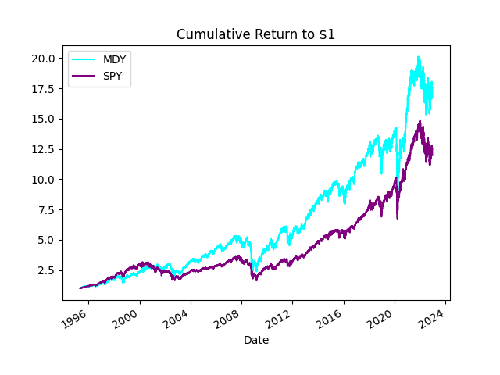
Import and view data (5)
mdy['cumret'].plot(label='MDY', color='cyan') spy['cumret'].plot(label='SPY', color='purple') plt.title('Cumulative Return to $1') plt.xlabel('Date') plt.legend() plt.savefig(path + 'returns.jpg') plt.show()
Plot charts
Options for charts
Export chart
Display chart in Python

Slide 19
In summary
Indices represent benchmarks of passive portfolios that require no input from an asset manager
ETFs are designed to allow individual investors to hold these passive positions
There are also active ETFs
The investors themselves may be active, and buy an ETF to take advantage of an investment thesis
Index returns are simply a weighted average return of individual stocks in the portfolio
Note that an ETF return will not necessarily match an index return
In testing an investment strategy, be wary of survivorship bias. Test on stocks that were available for investment at the time.

